Slide 1

GOVERNMENT ENGINEERING COLLEGE MAJALI, KARWAR 581345
Department of Computer Science and Engineering
Phase II Presentation on
“HATE SPEECH DETECTION USING MACHINE LEARNING”
Under the guidance of
Prof . Fayaz Shaikh.
Professor, Dept. of CSE
Presented By
HARISH KUMBHAR 2GP19CS009
PRAVEEN M R 2GP19CS018
SHREESHAIL S SANGAMAD 2GP19CS023
SHRISHAIL 2GP20CS410

Slide 2
HATE SPEECH DETECTION

Slide 3
TABLE OF CONTENT
01
INTRODUCTION
02
OBJECTIVE
03
MOTIVATION
04
LITERATURE SURVEY
05
EXISTING SYSTEM
06
PROPOSED SYSTEM
07
ALGORITHMS USED
08
CONCLUSION

Slide 4
ABSTRACT
Currently, active users on social media are growing rapidly and used to express opinions and feelings, social media and other online communication methods have begun to play a greater role in hate crimes. Such messages often hurt people, causing at times immense psychological distress and mental trauma to users. Instead of bringing people together, it causes digital divide and social alienation to many. It has now become a daunting task to manually moderate the comments and posts of users containing hate speech and explicit contents, so accurate and timely detection of abusive content on social media platforms is therefore very important for facilitating safe interactions between users. Due to the huge amount of data posted every day. Automatic method is essential for identifying this type of contents. The goal of our project is to identify hate speech in real time.

Slide 5
INTRODUCTION
The emergence of social media platforms has significantly altered how our world communicates in recent years, and one result of those changes is an increase in inappropriate behaviours like the use of aggressive and hateful languages.
The term ‘hate speech’ was formally defined as any communication that disparages a person or a group on the basis of some characteristics such as race, colour, ethnicity, gender, sexual orientation, nationality, religion, or other characteristics.
For years, social media companies such as Twitter, Facebook, and YouTube have been investing hundreds of millions of Euros every year on this task, but are still being criticized for not doing enough.
Our project's goal is to identify hate speech in time with high accuracy than previous models using a variety of algorithms based on machine learning, including Random Forest (RF), Naive Bayes (NB), Support Vector Machine (SVM), and K-Nearest Neighbour (KNN).

Slide 6
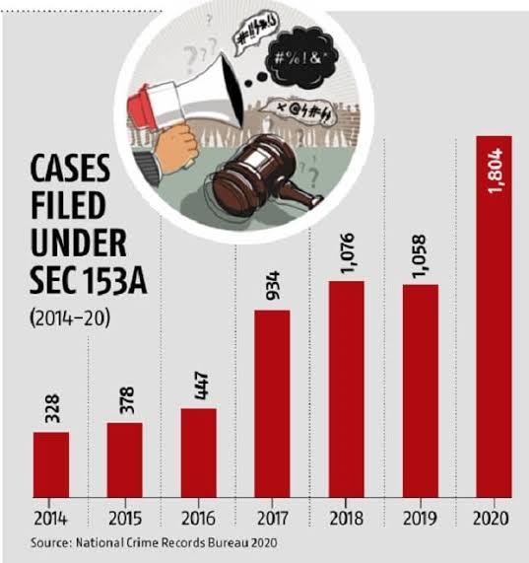
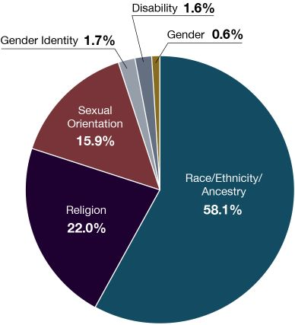
Fig 1 : Cases Filed Under Sec 153A
Fig 2 : Types of Speech

Slide 7
INTRODUCTION
In 2018/19, there were 103,379 hate crimes recorded by the police in England and Wales, an increase of 10% compared with 2017/18 (94,121 offences).
The majority of hate crimes were race hate crimes, accounting for around three-quarters of offences (76%; 78,991 offences). These increased by 11% between 2017/18 and 2018/19.
Sexual orientation hate crimes increased by 25 % (to 14,491 offences).
Religious hate crimes increased by 3% (to 8,566 offences).
Disability hate crimes increased by 14 % (to 8,256 offences).
Finally, transgender identity hate crimes increased by 37% (to 2,333 offences).

Slide 8
OBJECTIVES
The main goal of this project is to use a variety of machine learning techniques to build a classifier that can categories posts.
Nowadays, Teenagers use social media as well, and some social media platforms that contain offensive language or toxic content can have an impact on kids' minds. To counter this, we use hate speech detection.
In election time creating negative posts about politicians and some people's posts about race and religion during election season to catch that content.
Since there are many different traditions and religious groups in India, it's crucial to identify hate speech and explicit content as soon as possible in order to prevent violence against a particular religion.

Slide 9
MOTIVATION
Nowadays everyone is expressing their feelings and sharing thoughts on social. Sometimes these posts disparage a person or a group on the basis of some characteristics such as race, colour, ethnicity, gender, sexual orientation, nationality, religion, or other characteristics.
Students and teenagers are drawn to this type of content in today's world when the educational system is moving online.
These issues have been experienced by many famous persons, like the MS Dhoni incident and Common people have also encountered these issues.

Slide 10
LITERATURE SURVEY
Ref No. | Author | Title | Research | Accuracy and data used
[1] | Abhishek Velankar1, Hrushikesh Patil1, Amol Gore1,Shubham Salunke1 and Raviraj Joshi2 | Hate and Offensive Speech Detection in Hindi and Marathi | Different Deep learning architectures like CNN, LSTM, and variations of BERT like multilingual BERT, IndicBERT, and monolingual RoBERTa. | CNN model accuracy 84.1%, accuracy LSTM model 85.9%, Accuracy BiLSTM model 85.4%.
[2] | Sindhu Abro¹, Sarang Shaikh², Zafar Ali⁴ Sajid Khan⁵, Ghulam Mujtaba⁶ | Automatic Hate Speech Detection using Machine Learning: A Comparative Study | SVM and RF algorithms showed better results compared to LR, NB, KNN, DT, AdaBoost, and MLP. The lowest performance was observed in KNN. | The support vector machine algorithm best performed with 79% off overall accuracy.
[3] | KR Hingurage# and DS Vithanage | Hatred Comments Detection in Twitter using Deep Learning | Twitter data processing based on text mining that employs three machine learning algorithms: Naive Bayes (NB), Support Vector Machine (SVM), and Decision Tree (DT). | The LSTM model is used to train the data set and to get the probability values. The classes of hate speech were calculated against the training data set and were found to be above 72%.
[4] | Anita Saroj, Sukomal Pal | An Indian Language Social Media Collection for Hate and Offensive Speech | They collected social media posts in Hindi and English from Facebook and Twitter during the run-up to the parliamentary election 2019 of India (PEI data-2019). | Identified offensive tweets with an accuracy of 83.14 %, F1-score 0.7565 on the real test data for classification of offensive vs non-offensive.
[5] | Pabba Sumanth Syed Samiuddin K. Jamal ECE, GRIET y ECE, GRIET . ECE, GRIET . | Toxic Speech Classification using Machine Learning Algorithms | Improving the existing models- RF, DT, VC, LR, KNN. | among all algorithms Support vector machine and Logistic regression gave more accurate results.

Slide 11
EXISTING SYSTEM
Waseem employed a dataset of 16K tweets to categorize them as gender stereotypes, racial prejudice, or none of the above. He did the best, using the LR algorithm when compared to other techniques like character and word n-grams.
Gaydhani et al. used a mix of three datasets to perform logistic regression. She discovered that using logistic regression and a term frequency and inverse document frequency vectorizer resulted in a 95.6 percent accuracy.
Davidson, he analyzed a 24k tweet corpus that he divided into three categories: hate, offensive, and neither. He then used NLP techniques on the tweets, such as extracting the base form of word, text clustering, term frequency vectorization, and sentimental techniques of vader, before running various supervised learning algorithms, the best of which was LR with L-2 regularization.

Slide 12
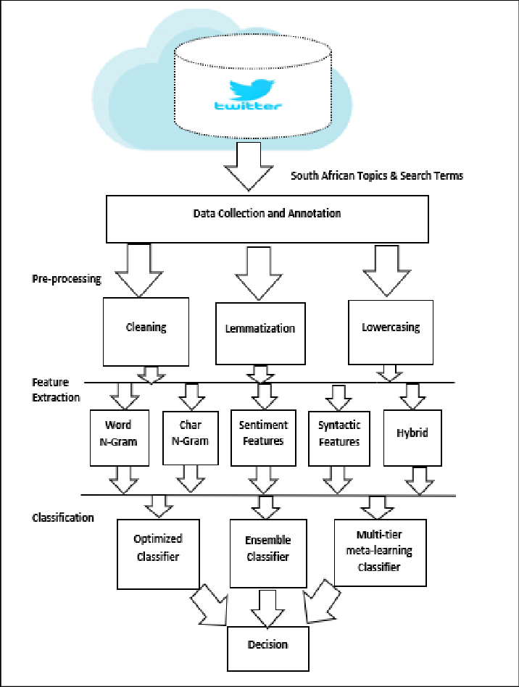
EXISTING SYSTEM
Pre-processing
Cleaning
Lemmatization
lowercasing
Feature Extraction
Word N-Gram
Char N-Gram
Sentiment Features
Syntactic Features
Hybrid
Classification
Optimized Classifier
Ensemble Classifier
Multi-tier Meta-Learning Classifier
Fig 3 : Tweeter text Classification

Slide 13
PROBLEM STATEMENTS
ACCURACY
The proportion of accurately predicted data points among all the data points is known as accuracy.
There are numerous algorithms that categories explicit content and hate speech, but their accuracy is lowered by the lack of local language data and the possibility that a single statement in another language could be non-hate.
TIME COMPLEXITY
The amount of time it takes for an algorithm to determine whether a post contains explicit or non-explicit content, hate speech or not.
After accuracy the timing is more important, to detect a hate speech and explicit contents (images and videos) to reduce conflicts and violence.
CLASSIFICATION OF SPEECH
The speech are of different categories such as Toxic, Obscene, Insult, Threat, Sexual, Hate, etc. Which remains unclassified.

Slide 14
PROPOSED SYSTEM
The purpose of the project is to put a set of comments into one of six categories, which are:
Toxic: A toxic comment is one that is unpleasant, disrespectful, or irrational and is likely to drive other users away from a conversation. Toxic comment classification is a subtask of sentiment analysis.
Severe Toxic: Adverse effects that arise following the repeated or continuous administration of a test sample for a significant portion of one's life span are referred to as Severe Toxic.
Obscene: When you say something is obscene, you're implying that it offends you because it involves sex or violence in a way that you find offensive and disturbing.
Insult: An insult is a purposefully rude action or manner of speech, as well as a lack of regard, esteem, or courteous behavior.
Threat: It refers to a threatening message in a terrifying manner or a threatening message in a frightening manner.

Slide 15
SYSTEM ARCHITECTURE
Pre-processing and Feature Selection
Different Classifiers
Predicted Results: toxic, severe_toxic, obscene, threat, insult, identity_hate
Dataset
Performance Analysis and Graph
Fig 4 : Simple Architecture of System

Slide 16
DATA FLOW DIAGRAM [DFD]
Input Dataset
Preprocessing
Training dataset
Different Classifiers
Prediction/Classification
Testing Data
Predicted Results: toxic, severe toxic, obscene, threat, insult, identity hate

Slide 17
ALGORITHM USED
Random Forest(RF) is a popular machine learning algorithm used for both classification and regression tasks. It belongs to the ensemble learning family of algorithms, which combines multiple decision trees to improve the overall performance of the model.
The algorithm works by constructing multiple decision trees during training time and aggregating the predictions of each individual tree to arrive at a final prediction. The individual decision trees are constructed using a random subset of the available features and training samples, which reduces the chance of over fitting and improves the generalization capability of the model.
The process of constructing a random forest involves the following steps:
Select random samples from a given dataset.
Construct a decision tree for each sample and get a prediction result from each decision tree.
Perform a vote for each predicted result.
Select the prediction result with the most votes as the final prediction.

Slide 18
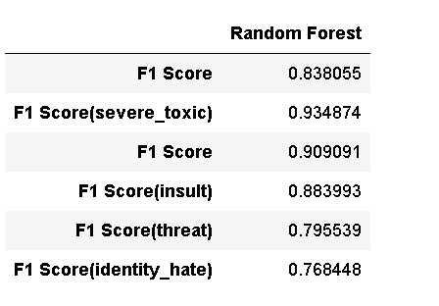
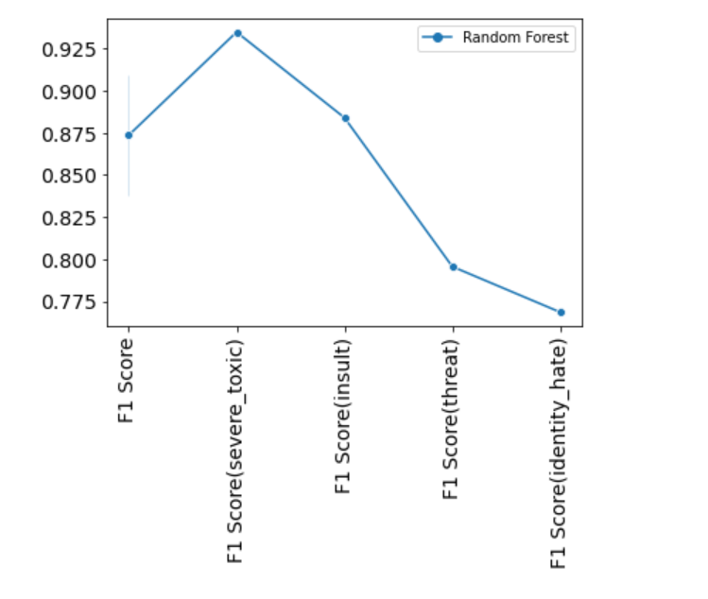
ALGORITHM USED
Fig 6 : F1-Score of Random Forest
Fig 7 : F1-Score of Random Forest

Slide 19
ALGORITHM USED
Support Vector Machine (SVM) is one of the most popular Supervised Learning algorithms, which is used for Classification as well as Regression problems. However, primarily, it is used for Classification problems in Machine Learning.
The goal of the SVM algorithm is to create the best line or decision boundary that can segregate n-dimensional space into classes so that we can easily put the new data point in the correct category in the future. This best decision boundary is called a hyperplane.
SVM chooses the extreme points/vectors that help in creating the hyperplane. These extreme cases are called as support vectors, and hence algorithm is termed as Support Vector Machine.
The dimensions of the hyperplane depend on the features present in the dataset, which means if there are 2 features (as shown in image), then hyperplane will be a straight line. And if there are 3 features, then hyperplane will be a 2-dimension plane.

Slide 20

ALGORITHM USED

Slide 21
ALGORITHM USED
Advantages of SVM
Effective in high-dimensional cases.
Its memory is efficient as it uses a subset of training points in the decision function called support vectors.
Different kernel functions can be specified for the decision functions and its possible to specify custom kernels.

Slide 22
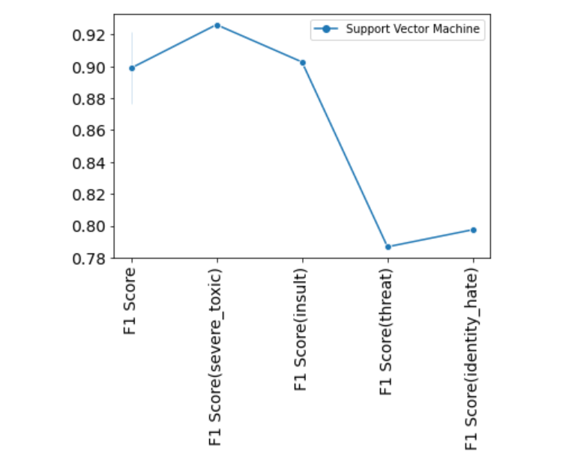
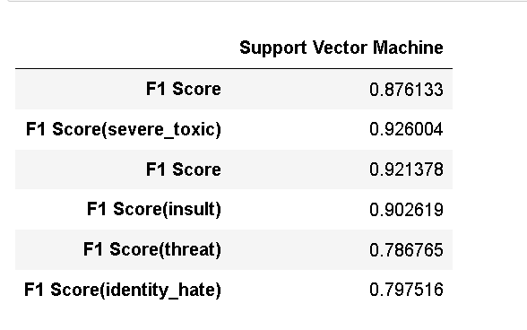
ALGORITHM USED
Fig 8 : F1-Score of Support Vector Machine
Fig 9 : F1-Score of Support Vector Machine

Slide 23
ALGORITHM USED
K-Nearest Neighbour is one of the simplest Machine Learning algorithms based on Supervised Learning technique.
K-NN algorithm assumes the similarity between the new case/data and available cases and put the new case into the category that is most similar to the available categories.
K-NN algorithm can be used for Regression as well as for Classification but mostly it is used for the Classification problems.
K-NN is a non-parametric algorithm, which means it does not make any assumption on underlying data.
It is also called a lazy learner algorithm because it does not learn from the training set immediately instead it stores the dataset and at the time of classification, it performs an action on the dataset.

Slide 24
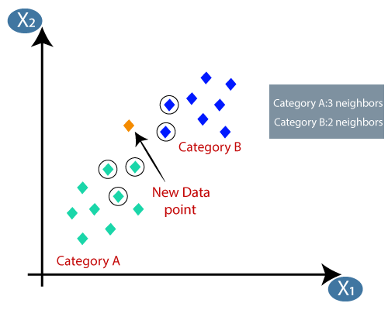
ALGORITHM USED

Slide 25
ALGORITHM USED
K-NN working :
Step-1: Select the number K of the neighbors
Step-2: Calculate the Euclidean distance of K number of neighbors
Step-3: Take the K nearest neighbors as per the calculated Euclidean distance.
Step-4: Among these k neighbors, count the number of the data points in each category.
Step-5: Assign the new data points to that category for which the number of the neighbor is maximum.
Step-6: Our model is ready.

Slide 26
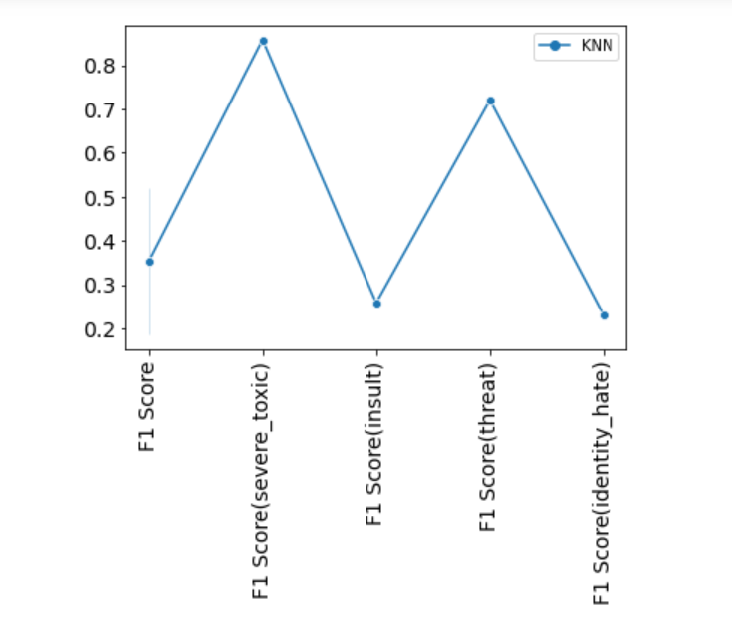
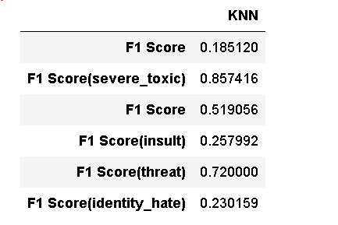
ALGORITHM USED
Fig 8 : F1-Score of KNN
Fig 9 : F1-Score of KNN

Slide 27
ALGORITHM USED
Naïve Bayes algorithm is a supervised learning algorithm, which is based on Bayes theorem and used for solving classification problems.
It is mainly used in text classification that includes a high-dimensional training dataset.
Naïve Bayes Classifier is one of the simple and most effective Classification algorithms
which helps in building the fast machine learning models that can make quick predictions.
It is a probabilistic classifier, which means it predicts on the basis of the probability of an object.
The Naïve Bayes algorithm is comprised of two words Naïve and Bayes
Naïve: If the fruit is identified on the bases of color, shape, and taste, then red, spherical, and sweet fruit is recognized as an apple. Hence each feature individually contributes to identify that it is an apple without depending on each other.
Bayes: It is called Bayes because it depends on the principle of Bayes' Theorem.

Slide 28
ALGORITHM USED
Where,
P(A|B) is Posterior probability: Probability of hypothesis A on the observed event B.
P(B|A) is Likelihood probability: Probability of the evidence given that the probability of a hypothesis is true.
P(A) is Prior Probability: Probability of hypothesis before observing the evidence.
P(B) is Marginal Probability: Probability of Evidence.
Suppose we have a dataset of weather conditions and corresponding target variable "Play". So using this dataset we need to decide that whether we should play or not on a particular day according to the weather conditions. So to solve this problem, we need to follow the below steps:
Convert the given dataset into frequency tables.
Generate Likelihood table by finding the probabilities of given features.
Now, use Bayes theorem to calculate the posterior probability.

Slide 29
ALGORITHM USED
There are three types of Naive Bayes Model
Gaussian
Multinomial
Bernoulli
Multinomial: The Multinomial Naïve Bayes classifier is used when the data is multinomial distributed. It is primarily used for document classification problems, it means a particular document belongs to which category such as Sports, Politics, education, etc.

Slide 30
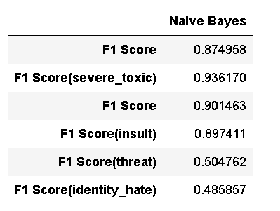
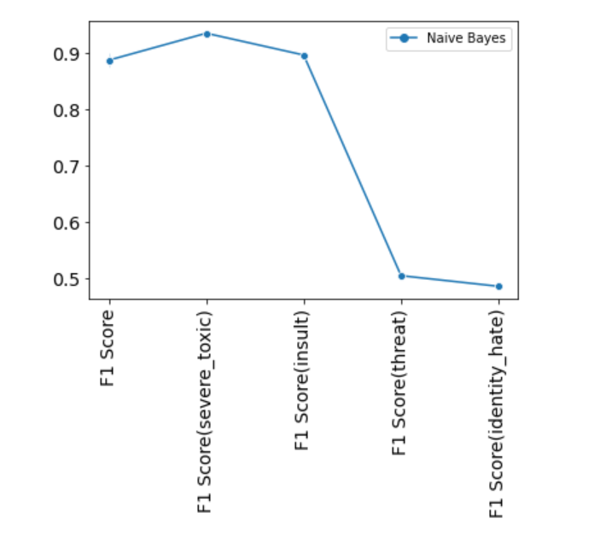
ALGORITHM USED
Fig 8 : F1-Score of Naïve Bayes
Fig 9 : F1-Score of Naïve Bayes

Slide 31
CONCLUSION
In this research, we mainly concentrated on the comments that are common among youth’s conversation in social media platforms. We created model using different classifier. We are able to classify the comments into six different categories, Random Forest and SVM Classifier gave more accurate results. The model not only categorizes a given sentence as hate or non-hate, but also provides percentages of Obscene, Toxic, Severe Toxic, Hate, Threat, and Identity Hate.

Slide 32
REFERENCE
Abhishek Velankar1, Hrushikesh Patil1, Amol Gore1, Shubham Salunke1 and Raviraj Joshi,” Hate and Offensive Speech Detection in Hindi and Marathi”, Dec 13-17, 2021, India.
Sindhu Abro, Sarang Shaikh, Zafar Ali, Sajid Khan, Ghulam Mujtaba, “Automatic Hate Speech Detection using Machine Learning: A Comparative Study”, 8, 2020.
KR Hingurage# and DS Vithanage, “Hatred Comments Detection in Twitter using Deep Learning”.
Anita Saroj, Sukomal Pal, “An Indian Language Social Media Collection for Hate and Offensive Speech”, PEI data-2019 Speech.
Kanwal Yousaf And Tabassam Nawaz, “An Indian Language Social Media Collection for Hate and Offensive Speech”, 2017.
Pedro V. A. de Freitas1, Antonio J. G. Busson1, Álan L. V. Guedes1, Sérgio Colcher1, “A Deep Learning Approach to Detect Pornography Videos in Educational Repositories”, 2020.

Slide 33
Thanks for Listening with great patience

